Slide 1
2024 Election The good, the bad and the ugly (Mostly ugly)
Presented by:
Bruce Elfant
Travis County Tax Assessor Collector & Voter Registrar

Slide 2
Keys to winning elections
Voter Registration
Voter Turnout
Voter Margin

Slide 3
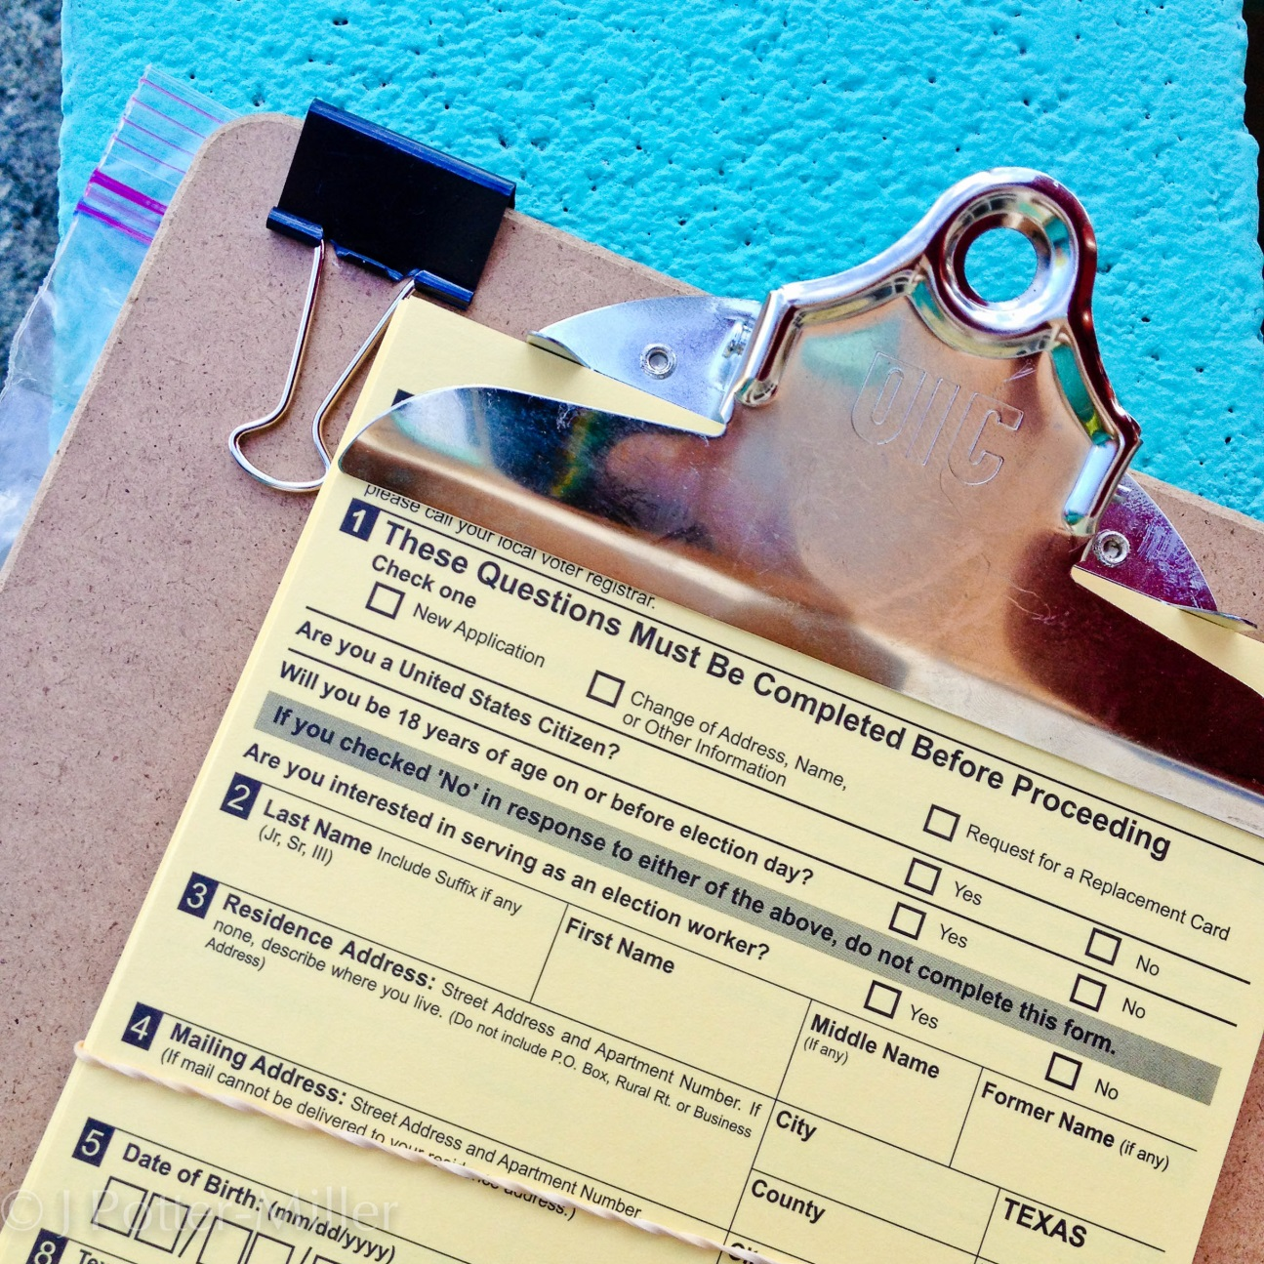
Voter Registration

Slide 4
Voter Registration – Top 10 Counties

Slide 5
Voter Registration - CenTX

Slide 6
Voter Registration increase 2020/2024

Slide 7
Voter Registration increase 2020/2024

Slide 8
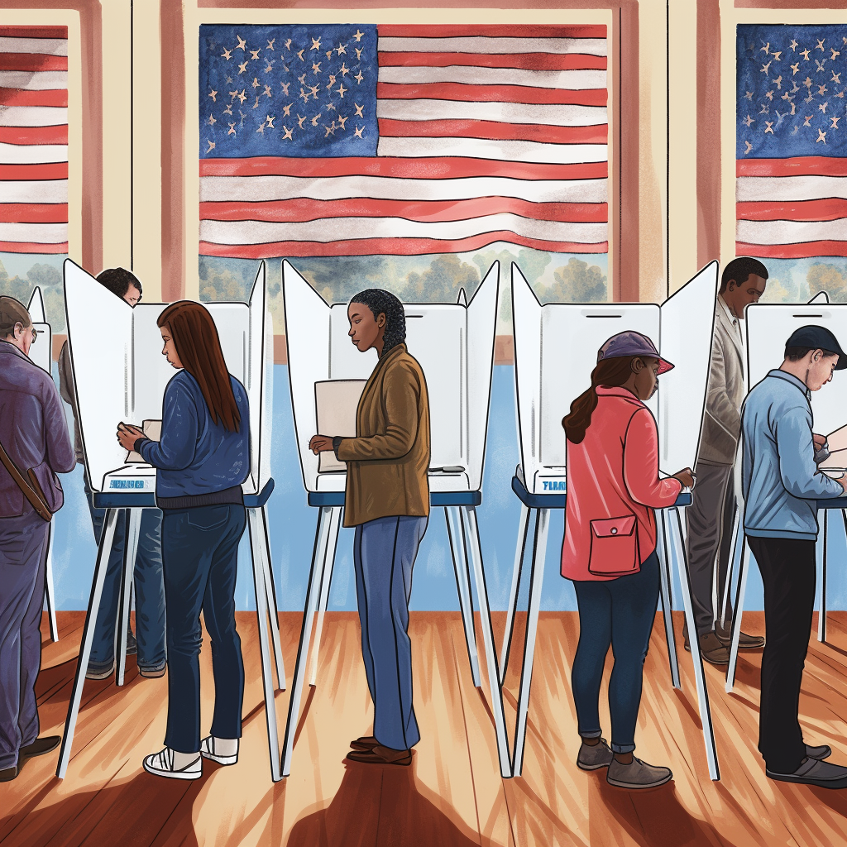
Voter Turnout

Slide 9
Voter Turnout - Top 10 Counties

Slide 10
Centex voter turnout

Slide 11
Voter Turnout 2020- 2024
COLLIN | -17.1
HARRIS | -11.1
DALLAS | -9.1
FT BEND | -8.6
HIDALGO | -8.1
TRAVIS | -7.2
EL PASO | -6.9
DENTON | -6.4
BEXAR | -6.4
TARRANT | -6.1

Slide 12
Travis County Voter Turnout

Slide 13
Vote Margin

Slide 14
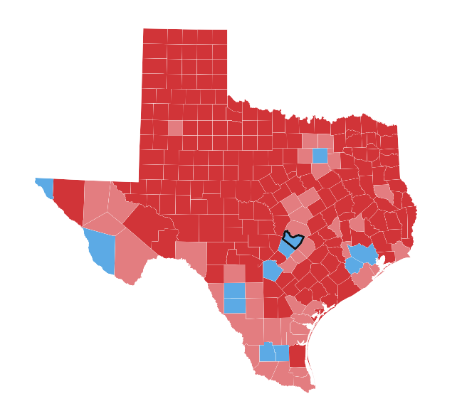

Slide 15
The Border

Slide 16
Harris Vote margin – Top 10 counties

Slide 17
2020 – 2024 Presidential margin

Slide 18
County population

Slide 19
Harris Margin
79,530

Slide 20
Harris vs Allred – Top 10 counties

Slide 21
Statewide margin of loss – Mid Term

Slide 22
Statewide Margin of Loss - Presidential

Slide 23
Travis County Margin of Victory - Midterm

Slide 24
Travis County Margin of Victory - Presidential

Slide 25
“For all those whose cares have been our concern,
the work goes on, the cause endures, the hope still
lives and the dream shall never die.”
- Edward M. Kennedy

