Slide 1
2026 PRIMARY Election
Lake Travis Democrats march 23, 2026
Presented by:
Bruce Elfant
Retired

Slide 2
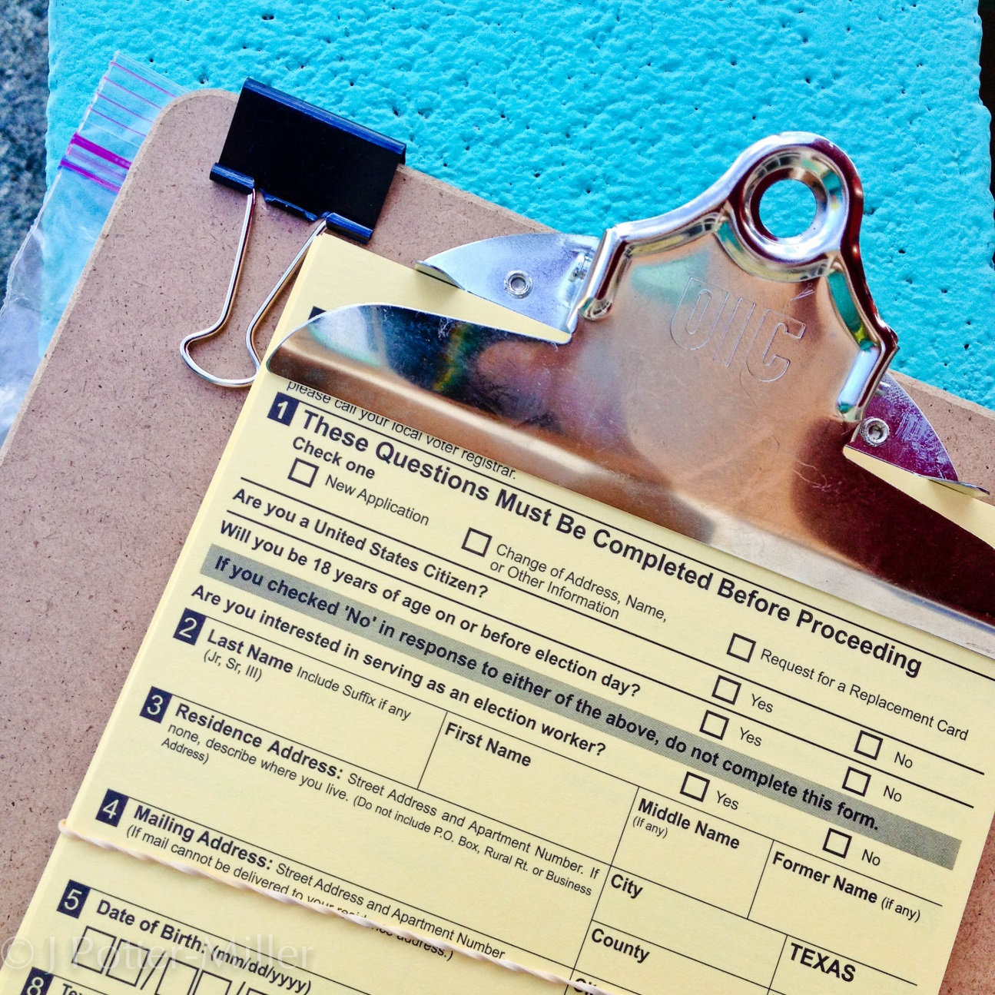
Voter Registration

Slide 3
Voter Registration

Slide 4
Voter Registration

Slide 5
Voter Registration

Slide 6
Voter Registration

Slide 7
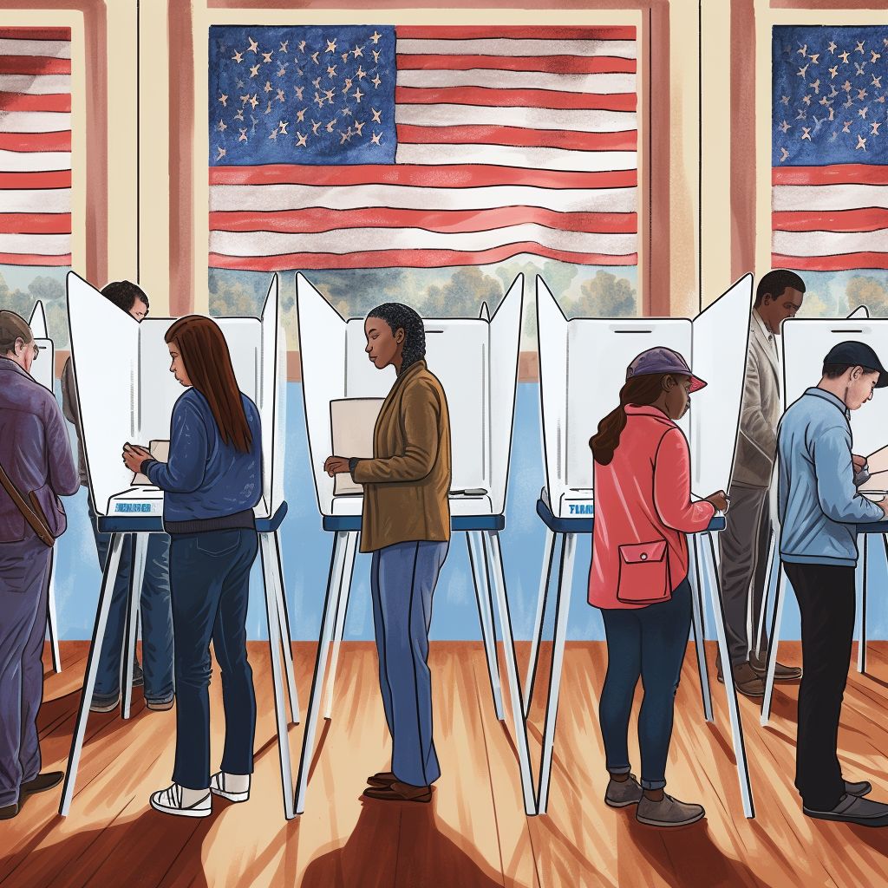
Voter Turnout

Slide 8
Turnout

Slide 9
Turnout

Slide 10
Turnout

Slide 11
Turnout

Slide 12
Turnout
Facebook Post
February 28 at 12:07 AM
Shared with Public
BREAKING NEWS
Williamson EV - 18.45%
Travis EV - 18.57%
More in the morning.

Slide 13
Turnout

Slide 14
Turnout

Slide 15
Turnout

Slide 16
Turnout

Slide 17
Turnout

Slide 18
Turnout

Slide 19
Turnout

Slide 20
Turnout

Slide 21
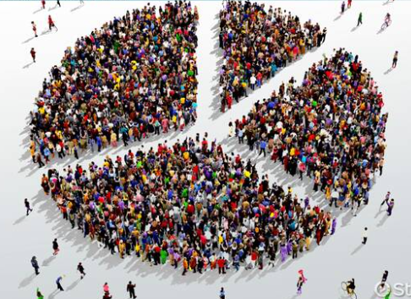
Who Voted?

Slide 22
Turnout
State-wide All GOP Gender
<30 - 14% <30 - 4% F/M
50+ - 55% <49 - 22% GOP - 50/50
50+ - 78% Dem - 60/40
70+ - 33%

Slide 23
Turnout
Travis County Voters - Age
Reg. Voters All Voters First Time Voters
18-34 34.5% 28% 50%
35-54 36.6% 37.3% 32.5%
55+ 29% 34.4% 16.5%

Slide 24
Turnout
Travis County Primary Vote Frequency
4 Dem Primaries 14%
3 Dem Primaries 22%
2 Dem Primaries 23%
First Dem Primary 38%
Mixed Primary 2%

Slide 25
Turnout
Travis County - Gender
Women – 57%
Men – 43%

Slide 26

Takeaways

Slide 27
Takeaways
Highest Mid-term Primary Turnout Since 1990

Slide 28
Takeaways
Highest Mid-term Primary Turnout Since 1990
Highest Primary Democratic Margin Since 2002

Slide 29
Takeaways
Highest Mid-term Primary Turnout Since 1990
Highest Primary Democratic Margin Since 2002
Surge in first time voters

Slide 30
Takeaways
Highest Mid-term Primary Turnout Since 1990
Highest Primary Democratic Margin Since 2002
Surge in first time voters
Larger Enthusiasm Gap (78%-64%)

Slide 31
TakEaways
Highest Mid-term Primary Turnout Since 1990
Highest Primary Democratic Margin Since 2002
Surge in first time voters
Larger Enthusiasm Gap (78%-64%)
Republican Election Day Stunt backfires

Slide 32
Takeaways
Highest Mid-term Primary Turnout Since 1990
Highest Primary Democratic Margin Since 2002
Surge in first time voters
Larger Enthusiasm Gap (78%-64%)
Republican Election Day Stunt backfires
Not a great night for incumbents

Slide 33
“Our lives begin to end when
we remain silent
about the things that matter.”
- Rev. Martin Luther King

Slide 34


